Slide 1



FINAL PROJECT PRAKTIKUM SBD GROUP AA27
TransUI

Slide 2

Members:
Rezki Muhammad
Leonardo Jeremy
Aliefya Fikri Ihsani

Slide 3

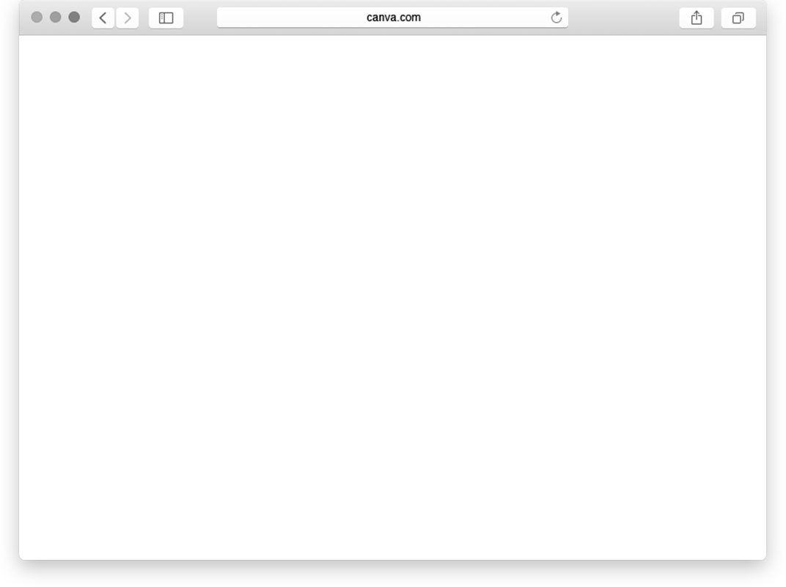

TransUI
The app can provide comprehensive information about various public transportation modes within and to/from UI (University of Indonesia). It can display data, schedules, and availability status of spekun (bicycle sharing), bikun (public university bus), ojek (motorcycle taxis), and KRL (electric train) services. Users can access this information to plan their journeys effectively.

Slide 4



Bikun (Public University Bus)
Sepeda
Features
KRL (Electic Train)
Ojek (Motorcycle Taxis)
Wallet

Slide 5
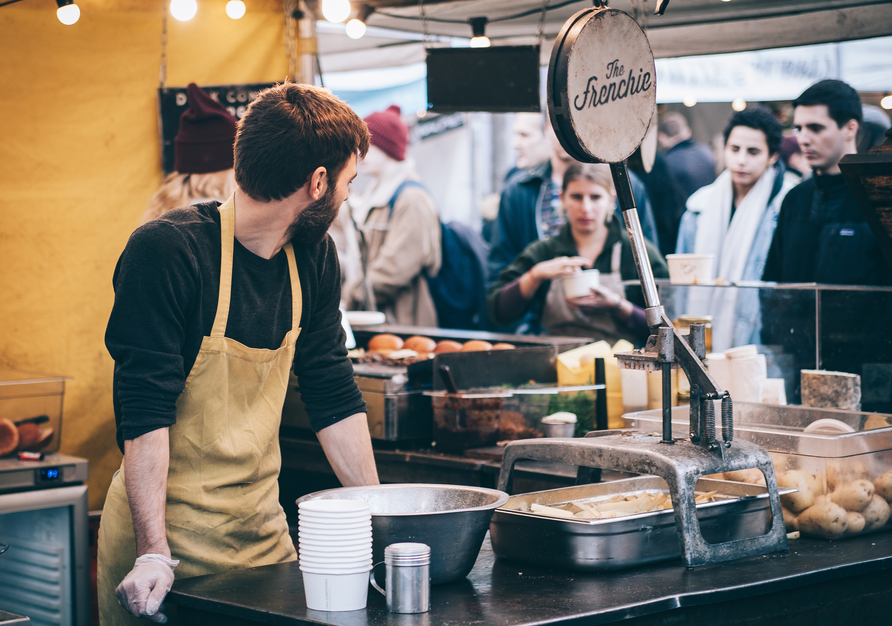
As an Admin
As a User
Admins have the authority to manage user accounts, including creating new accounts, updating user information, and addressing any user-related issues. They are responsible for monitoring and managing the transportation schedules, updating and maintaining the accuracy of bikun and KRL information. Additionally, admins have access to manage the drop location of bicycles and informations of the bicycles itself.
Users can view data, schedules, and availability status of ojek, spekun, bikun, and KRL services. Additionally, they can browse the available spekun options, select a preferred bicycle, and complete the rental process through the app. Users can also stay informed about transportation schedules, tracking the arrivals and departures of bikun and KRL services. Furthermore, users have access to a wallet feature within the app, allowing them to manage their balance, top up funds, and conduct seamless transactions for spekun rentals.

Slide 6

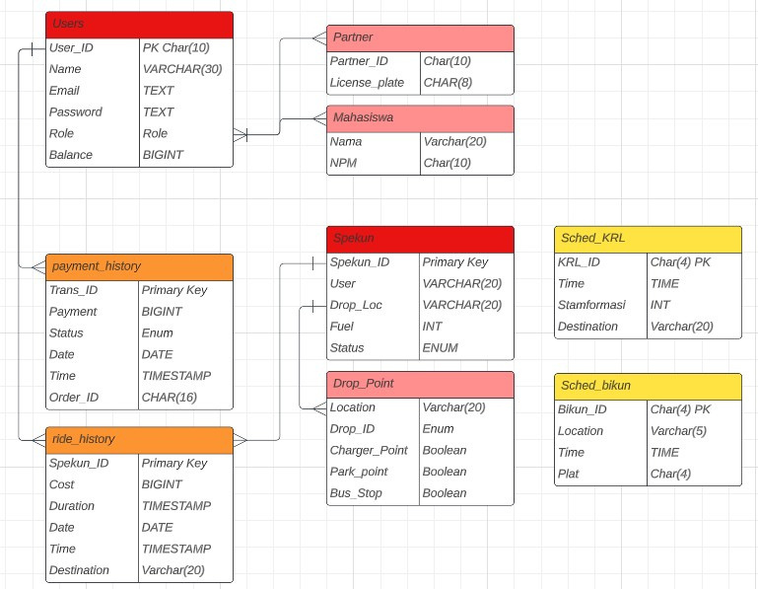
UML

Slide 7
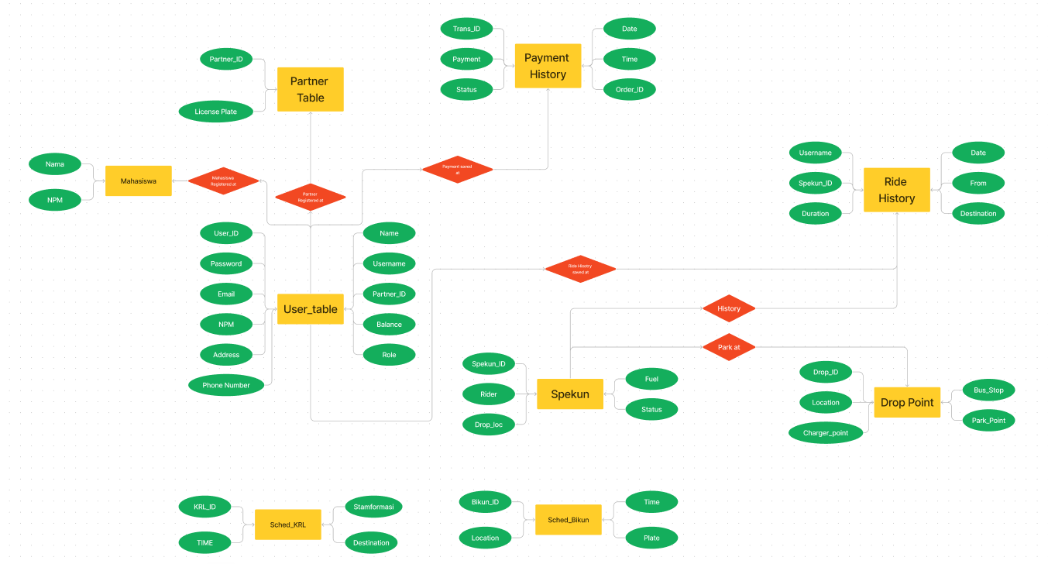
ER Diagram

Slide 8
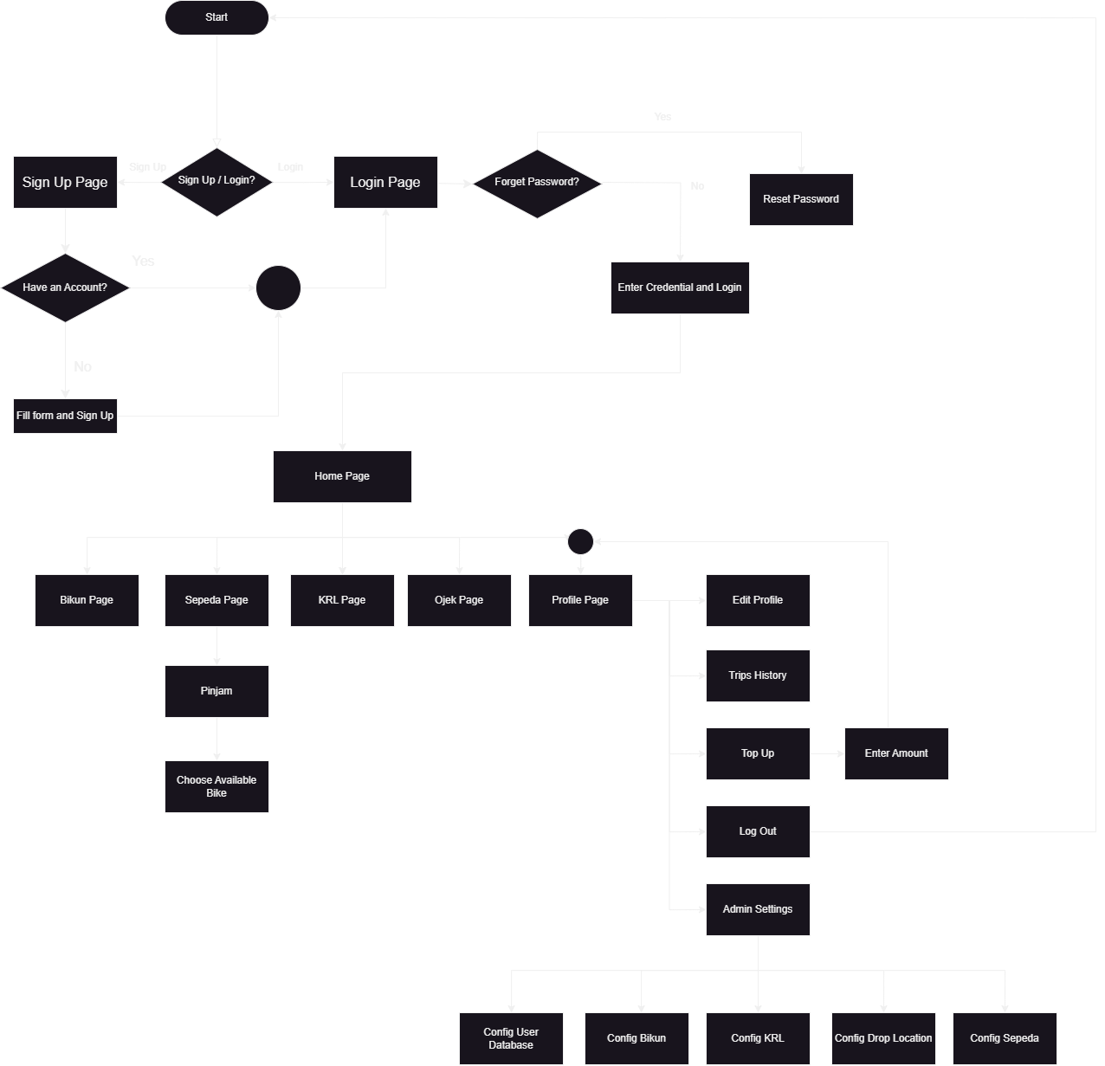
Flowchart

Slide 9

Thank you

